Slide 1





Slide 2
Who am I?
Matt Christensen
Software dev manager for a job
Game programming as a hobby
Fell down an 8-bit computing/console rathole
Not an expert!

Slide 3
Scope for today
Write a 2600 program than demonstrates
The 8bitworkshop IDE
Assembly language
Drawing background color, playfield, and sprites

Slide 4
A note
Goal is to keep code as simple as possible
Notes:
This is a survey course
I will always err on the simpler/more obvious way of doing things
Note “real” 2600 dev involves a lot of optimization and doing things the clever way

Slide 5
Seizure warning
Easy to make screen blink
Some exercises will make screen blink
Be careful if you have seizures!
You can always use the “power” button to turn it off
Let me know if this will be an issue!

Slide 6
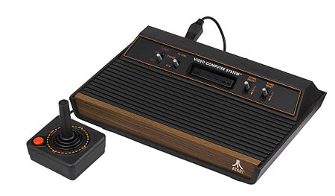
Atari 2600
Notes:
ATARI VCS
“Video Computer System”
Not first! Predicated by Magnavox Odyssee, Fairchild channel F, and Pong

Slide 7
Sales
1977
Released for $199
With 9 games
1980
Space invaders first big hit
2 million sales
2 billion in revenue
1982
10 million total sales
7 million of Pacman!
1983
Video game crash
1992
Discontinued
30 million sold
Notes:
$840 today

Slide 8
Basic architecture
MOS 6507 at 1.19 MHz
128 byte RAM
4kb ROM size
NTSC 128 colors, 60 fps, 160x192
Custom chip - TIA
Notes:
6502 with smaller package so smaller address space, cheaper
Cart interface even smaller, so total of 4096 bytes of ROM
Combat only 2KB Atari/Apple I/II/C64/NES
Television Interface Adaptor – screen, sound, controller
PIA – RAM/timer/

Slide 9
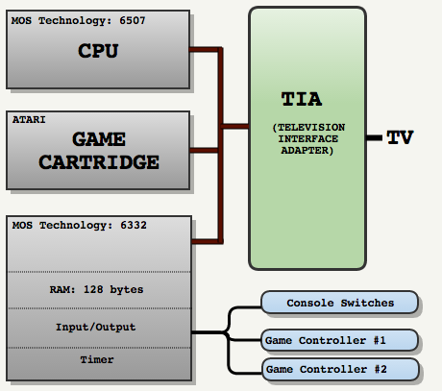
http://fabiensanglard.net/learning_legendary_hardware/index.php

Slide 10
Context - text
"Learn the basics of writing games on the Atari 2600 in 6502 assembly. This will be participatory, so bring a laptop if you'd like to code along! No software needed other than a web browser."
"Learn the basics of writing games on the Atari 2600 in 6502 assembly. This will be participatory, so bring a laptop if you'd lik"

Slide 11

Context - framebuffer

Slide 12
Why so restricted?
Trying to make as inexpensive as possible
8K of ram $125
6507 vs 6502 - $12 vs $25
At cost of only 8k addressable
An base Apple II cost $1298 (aka $5,500 now!)

Slide 13
games

Slide 14
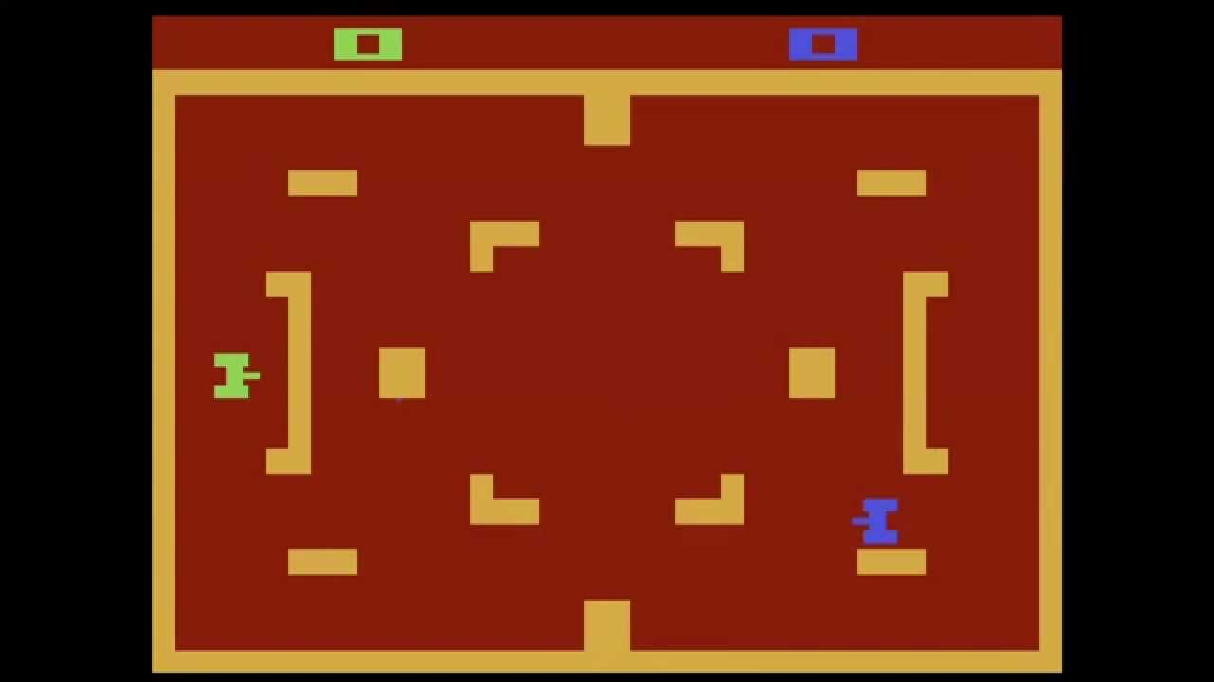
combat

Slide 15
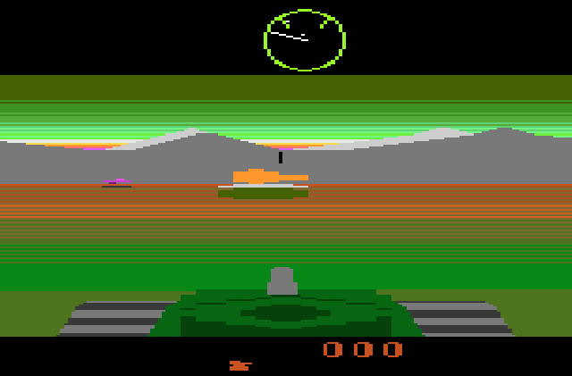
battlezone

Slide 16
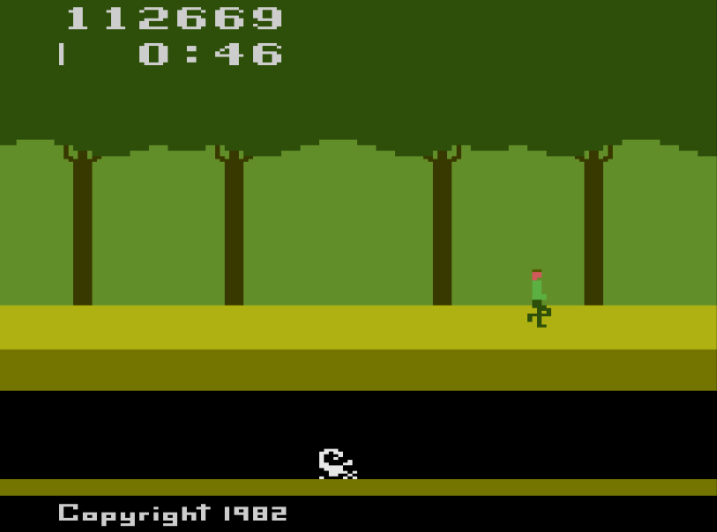
pitfall
Notes:
256 rooms. Each byte represents the stuff in the room. 1/16th of whole cart! Found an interesting formula that generated playable games.

Slide 17
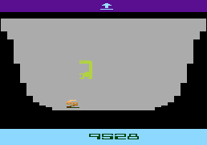
et

Slide 18
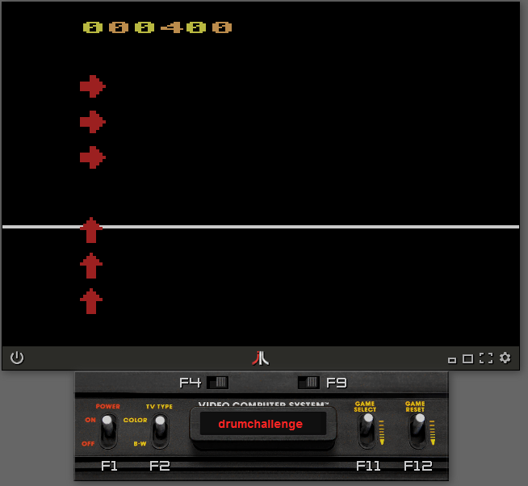

Slide 19
But why?

Slide 20
Bad reasons
I have a game idea
I want to be rich
I want to be famous
Notes:
It’s just too restrictive. You have to shape your ideas ot the platform.

Slide 21
Good reasons
Game preservation/archeology
Technical challenge
Game design challenge
Joy of constraints
Can understand the entire stack
Develop without obsessing about monetization
80’s nostalgia

Slide 22
Exercises
http://8bitworkshop.com/
https://github.com/moosepod/atari2600_workshop/tree/master/exercises
https://git.io/fjGlf

Slide 23
Exercise 0
Bills blue background

Slide 24
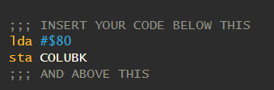
Exercise 0: background color
Open up 8bitworkshop.com
Platform->Game Consoles->Atari 2600
New Project, name atariworkshop.asm
Copy code from exercise0.asm
Should see black screen
What happens when you change number?

Slide 25
Exercise 0: binary, hex, and decimal
#129
#$81
10000001
Notes:
1 100, 2 tens, 8 ones
8 sixteens, one 1
1 128, 1

Slide 26
Exercise 0: background color
Framebuffer too expensive
TIA draws based on settings of registers
Notes:
Explain assembly (maps right to machine language)
Explain HEX
Explain memory and registers
Note that some actually hook through to other things, like the TIA chip
Intro to TIA
tens of thousands of dollars per megabyte.^{[4]} A typical 320 by 200 pixel display with even a single bit per pixel would require 8000 bytes of memory to store the framebuffer.^{[2]}

Slide 27
Exercise 0: background color
Address
$00-$7F | TIA Registers
$80-$FF | PIA RAM
$280-$297 | PIA PORTS/TIMER
$F000-$FFFF | Cartridge ROM
Notes:
COLUBK 09
https://github.com/munsie/dasm/blob/master/machines/atari2600/vcs.h

Slide 28
Exercise 0: background color
lda – “load to accumulator”
sta – “store accumulator value”
Notes:
Accumulator special register on chip
Assembly uses these registers

Slide 29
Exercise 0: background color
X = 10
LDA #$0A
STA $11
Notes:
Everything goes through registers
Assembly maps directly to machine code, which the chip can then interpret directly

Slide 30
Exercise 1
CYCLING background color

Slide 31

Exercise 1: blinking background color
Copy exercise1.asm into atariworkshop.asm
Enter code to right
What happens?
Notes:
- You have access to the A, X and Y registers
- DEX decrements the X register.

Slide 32
Exercise 2
CYCLING COLOR LINES

Slide 33
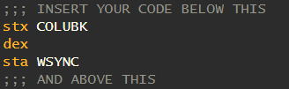
Exercise 2: Cycling color lines
Copy exercise2.asm into atariworkshop.asm
Note we start from the code in in exercise1
Add code to right
What happens?
Notes:
- You have access to the A, X and Y registers
- DEX decrements the X register.

Slide 34
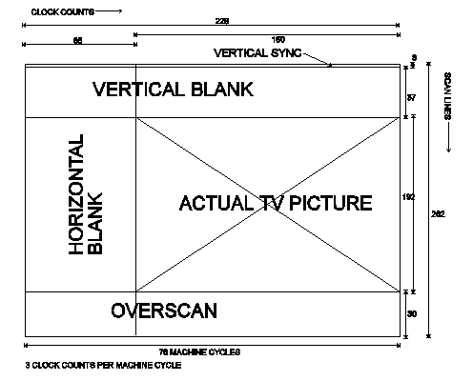
Notes:
“Racing the beam”
NTSC Screen model
WSYNC – sets timer to wait until next horizontal blank

Slide 35
Exercise 3
Smooth background color cycling

Slide 36
Exercise 3: Smooth background color cycling
Copy exercise3.asm into atariworkshop.asm
OK, that’s a lot of new stuff. Let’s walk through it.

Slide 37
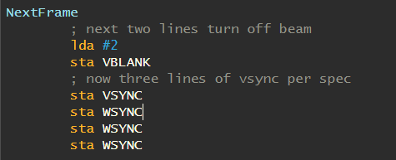
Exercise 3: VSYNC

Slide 38
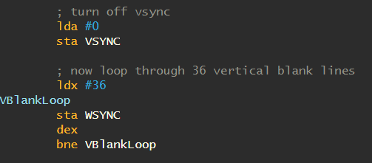
Exercise 3: VBLANK
Notes:
Note _36_ lines when total vsync is 37
VSYNC is used for game logic, positioning, etc.

Slide 39
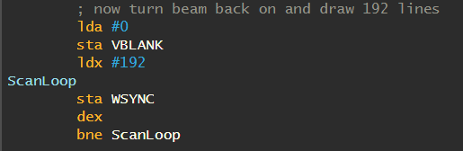
Exercise 3: scanlines
Notes:
Now lines are being drawn, based on settings in TIA

Slide 40
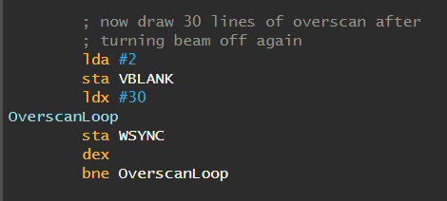
Exercise 3: Overscan
Notes:
- In overscan area
Turn off beam
Can use this time for more logic if wanted

Slide 41
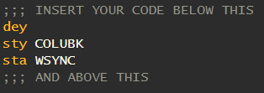
Exercise 3: color cycle
Kind of intense! Turn it off fast ☺
Notes:
- Ask for explanation of what’s going on

Slide 42
Exercise 4
slower background color cycling

Slide 43
Exercise 4: slower background color cycling
Copy exercise4.asm into atariworkshop.asm
Three parts
Define variables
Initialize variables
Change loop to use variables
Notes:
- Ask for explanation of what’s going on

Slide 44
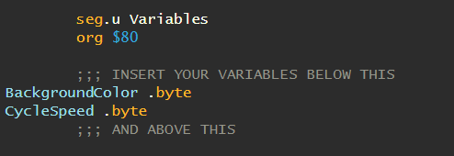
Exercise 4: define variables
Notes:
Variables are just memory locations
Only 128 bytes of ram
And remember a byte is only 255 variables! Enough for a standard ascii character
We declare two bytes. Can also declare words and blocks of memory (ds)
Assembler declares where – but the $80 means they’ll beat locations $80 and $81. $80 is where ram starts

Slide 45
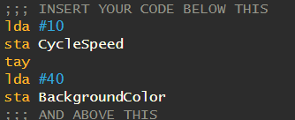
Exercise 4: initialize variables
Notes:
TAY – Transfer A to Y

Slide 46
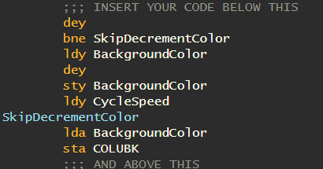
Exercise 4: LOOP
Notes:
Walk through logic
We decrement Y once per main loop
When it hits 0, decrement background color AND reset the counter
Note that in assembly you can only check equal to 0. So it’s slightly easier/faster to count down than up
Net result is color shifts every N frames

Slide 47
Exercise 4: experiments
In your init block, try different values for BackgroundColor and Cycle Speed
Try “SBC 1” and “SBC 16”
Why doesn’t background color transition more smoothly?
http://www.randomterrain.com/atari-2600-memories-tia-color-charts.html

Slide 48
Exercise 5
Playfield – top/bottom

Slide 49
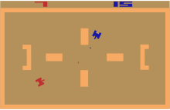
Exercise 5: the playfield
Notes:
Describe combat

Slide 50
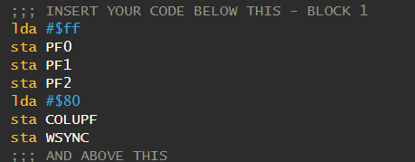
exercise: playfield top/bottom
Notes:
Ask to run – what happens? Looks just like a background color

Slide 51
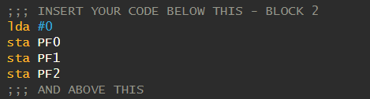
exercise: playfield top/bottom
Notes:
Ask to run – what happens?

Slide 52
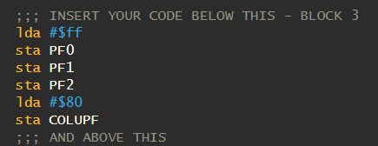
exercise: playfield top/bottom
Notes:
Now we have top and bottom bars
Question for audience – we don’t clear the playfield again. Why don’t we see blue wrapping around
- Comment out vblanks to see (answer is VBLANK)

Slide 53
Exercise 6
Playfield - sides

Slide 54
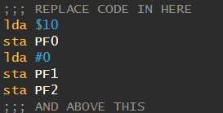
Exercise 6 – Playfield sides
Notes:
Note I am using HEX not DEC (will make more sense later)
What do you see?

Slide 55
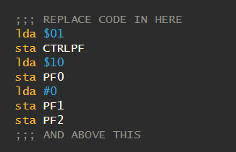
Exercise 6 – Playfield sides
Notes:
Now what happens?

Slide 56
Exercise 7
Players and sprites

Slide 57
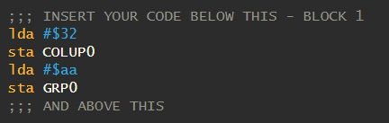
Exercise 7 – players and sprites

Slide 58
Exercise 7 – players and sprites
Sprite/player explanation here
GRP0/GRP1, 8 bits
COLUP0/COLUP1 (color)

Slide 59

Exercise 7 – players and sprites
Notes:
What changed?
Sprites stay “on” until turned off

Slide 60

Exercise 7 – players and sprites
Notes:
Change number between 1 and 13. What happens?
Sprite location is set to position of _beam_ when RESP0/RESP1 strobed
This only allows for a coarse position. Better positioning is possible but out of scope ☺

Slide 61
Exercise 8
Multiline sprites

Slide 62
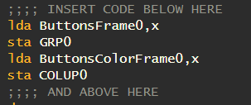
Exercise 8: multiline sprite
Notes:
What happens?

Slide 63
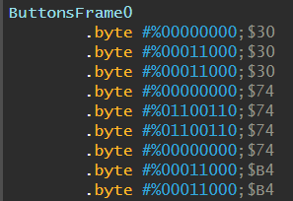
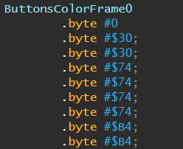
Exercise 8: multiline sprite
Notes:
Explain indexing
Note why I have the “0” spacer at the bottom
Note difficulty with colors
Each sprite is only 8 bits wide! Limits what you can do

Slide 64

Exercise 8: building sprites
https://alienbill.com/2600/playerpalnext.html

Slide 65
What if I want
Random numbers – do it yourself!
Saving games – nope
Draw shapes – do it yourself!
Text – do it yourself!
Floating point math – good luck!
Ray tracing - lol

Slide 66
6502 learned
6502
LDA
STA
LDY/LDX
TAY/TAX
DEX/DEY
BNE
2600 registers
VBLANK
WSYN
COLUBK
PF0
PF1
PF2
COLUPF

Slide 67
What can I do with this newfound knowledge?
Make 2600 games!
Make Atari 400/800 games!
Make NES games!
Make Apple II games!
Make C64/Pet/VIC-20 games!
Make Atari Lynx games!
Learn x86 assembly!

Slide 68
Credits/references
Books/GUIDE
Tools
“Making Games for the Atari 2600” by Steven Hugg
“Racing the Beam” by Nick Montfort
Stella guide
https://atarihq.com/danb/files/stella.pdf https://alienbill.com/2600/101/docs/stella.html
http://www.obelisk.me.uk/6502/reference.html
Stella emulator
Atariage.com
http://www.randomterrain.com/atari-2600-memories-tia-color-charts.html (color chart)
https://alienbill.com/2600/playerpalnext.html

Slide 69
Games that can help with assembly
TS-100
Shenzen I/O
Exapunks

Slide 70
Exercise 9
Reading the joystick

Slide 71
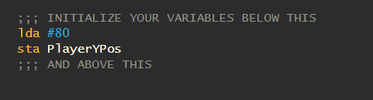
Exercise 9: reading the joystick
Notes:
Change the value here. What happens?
Walk through how we changed the code to be variable, instead of fixed # of lines

Slide 72
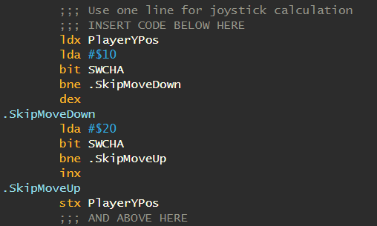
Exercise 9: reading the joystick
Notes:
Joysticks Up/Down/Left/Right stored in an address SWCHA
Bit tests that any of bits in the “mask” are set. If so, Z is 1. else Z is 0. BNE = branch not equal = Z=0
What happens

Slide 73
Exercise 10
Bounds check

Slide 74
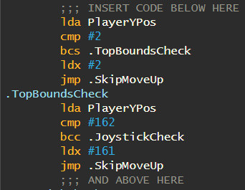
Exercise 10: bounds check
Notes:
Cmp is actually a subtract!
Beq = branch if equal
Bne = branch it not equal
Bcc = branch if <
Bcs = branch if >=
Why not using actual collisions? Remember how we drew the lines. Will overflow before we get there!

Slide 75
Exercise 11
sound

Slide 76
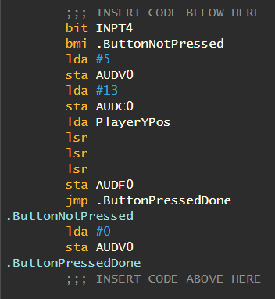
Exercise 11: sound

Slide 77
Exercise 12
Horizonal fine position

Slide 78
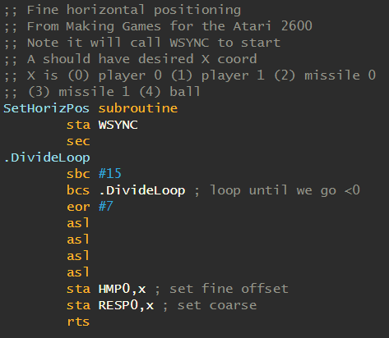
Exercise 12: horizontal fine position

Slide 79
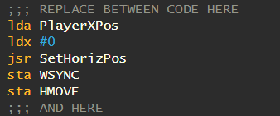
Exercise 12: horizontal fine position

Slide 80
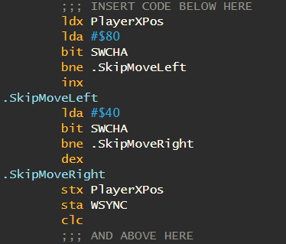
Exercise 12: horizontal fine position

Slide 81
Exercise 13
Collisions and timers

Slide 82


Exercise 13: collisions and timers

Slide 83
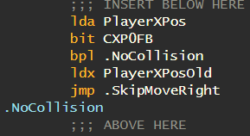
Exercise 13: Collisions and timers

Slide 84
Exercise 14
More sound more color

Slide 85
Exercise 14: More sound more color
Add second sound channel based on horizontal
Cycle playfield colors

Slide 86
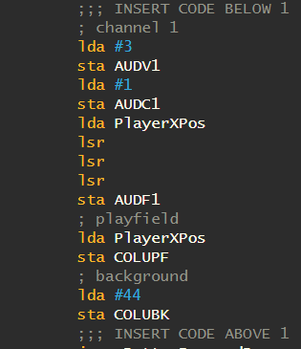
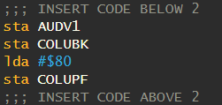
Exercise 14: More sound more color

